Slide 1
Pythagoras Finding the Hypotenuse
Year 9 Mathematics

Slide 2
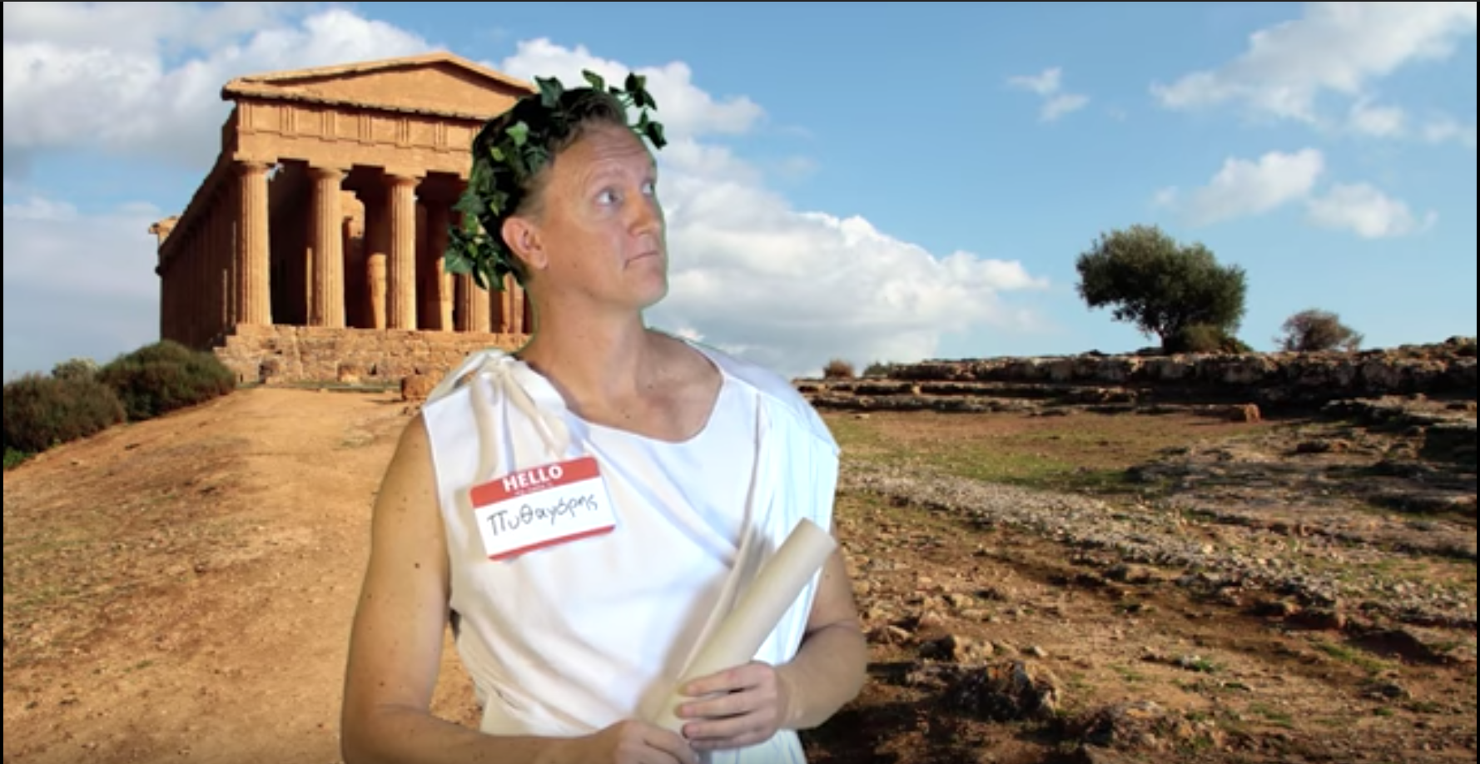
Pythagoras Theorem
https://www.youtube.com/watch?v=WqhlG3Vakw8

Slide 3
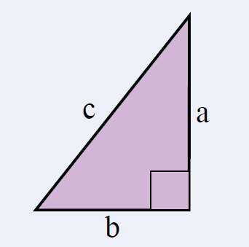

24
7
30
Topic: Pythagoras Theorem
Date: /10/2018
EQ – What is the Pythagoras Theorem?
For any right-angled triangle:
The square of the hypotenuse is equal to the sum of the squares of the other two sides
The hypotenuse is the longest side of a right-angled triangle.
It is opposite the right angle.

Slide 4
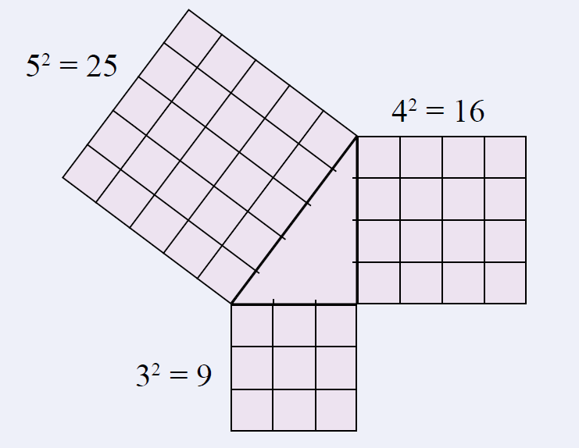
24
7
30
Topic: Pythagoras Theorem
Date: /10/2018
EQ – What is the Pythagoras Theorem?
For any right-angled triangle:
The square on the hypotenuse is equal to the sum of the squares on the other two sides
Example:

Slide 5
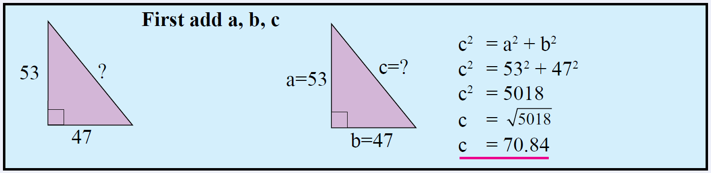

24
7
30
Topic: Pythagoras Theorem
Date: /10/2018
EQ – What is the Pythagoras Theorem?
Worked Example:
Find the length of the hypotenuse in this right-angled triangle.
How do we find the length of the hypotenuse?

Slide 6

We Do
What side is the hypotenuse?
Determine the length of the hypotenuse.
Answers
The hypotenuse is side f.
d = 12cm
$$f^{2}=d^{2}+e^{2}$$
$$f^{2}={12}^{2}+5^{2}$$
$$f^{2}=144+25$$
$$f^{2}=169$$
$$f=\sqrt{169}$$
$f=13$ cm
e = 5cm
f

Slide 7


Slide 8
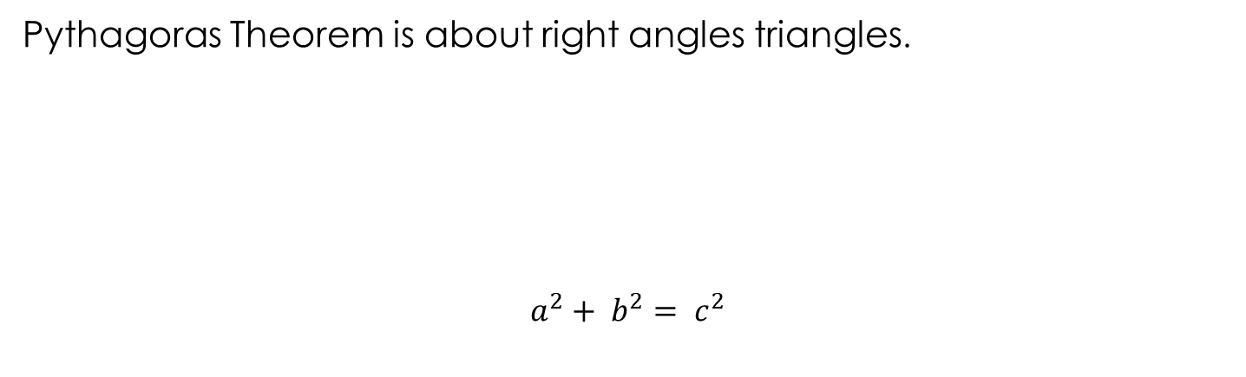
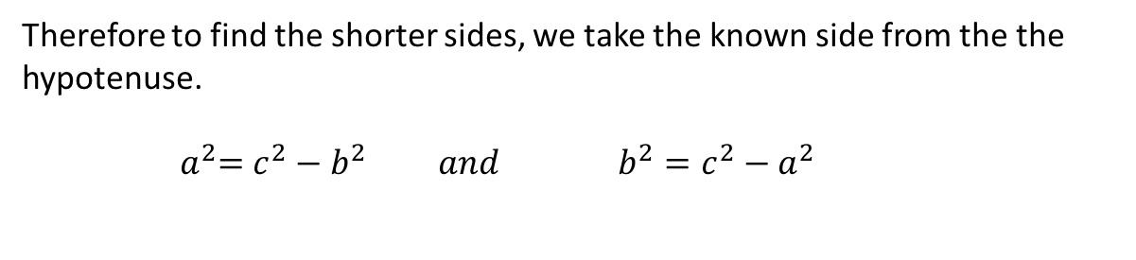
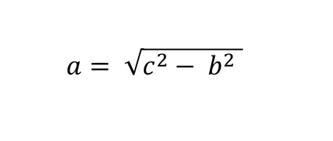
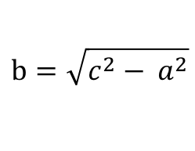
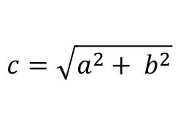
24
7
30
Topic: Pythagoras Theorem
Date: /06/2018
EQ – How do I calculate the shorter side of a right-angled triangle?
Pythagoras Theorem is about right angles triangles.
$$a^{2}+ b^{2}= c^{2}$$
C - Hypotenuse
Side 2- A
B – Side 1
Therefore to find the shorter sides, we take the known side from the the hypotenuse.
$${ a}^{2}=c^{2}−b^{2} and b^{2}=c^{2}−a^{2}$$
Remembering our algebra skills, to remove the square on the left, we square root the right hand side
$a= \sqrt{c^{2}− b^{2} }$
$$b=\sqrt{c^{2}− a^{2}}$$
$$c=\sqrt{a^{2}+ b^{2}}$$

Slide 9





24
7
30
Topic: Pythagoras Theorem
Date: /06/2018
EQ – How do I calculate the shorter side of a right-angled triangle?
shorter side
$$x^{2}= {20.4}^{2}− {9.6}^{2}$$
$=416.16−92.16$
$$=324$$
$$9.6 cm$$
$$x$$
$$x= \sqrt{324}$$
$=18 cm$
$$20.4 cm$$
hypotenuse

Slide 10

We Do
Determine the length of the unknown side of this right-angled triangle.
$$e^{2}=f^{2}−d^{2}$$
$$e^{2}={10}^{2}−8^{2}$$
$$f^{2}=100−64$$
$$f^{2}=36$$
$$f=\sqrt{36}$$
$f=6$ cm
d = 8 m
e
f = 10 m

